Slide 1
CDF, Inc. Analysis Talent Management
DDSAnalytics
By Solange Garcia de Alford

Slide 2
DDSAnalytics
Executive Summary
Talent management is at the forefront of CDF’s business strategy. One of the most valuable assets at CDF are the Employees that form the company.
CDF’s decision to analyze the company’s attrition is to ensure CDF continues to maintain its place as the leader in the industry. Each one of CDF’s Employees is key to the success of the enterprise and to gain a competitive edge over its competition.
DDSAnalytics was engaged by CDF to provide business intelligence to help retain its employees.
This analysis covers:
Attrition Trends
Attrition Prediction Model
Top 3 factors contributing to CDF’s employee turnover

Slide 3

DDSAnalytics Employee Data
DDSAnalytics worked with a data set of 1,470 CDF’s employee records.
The data included important information on these employees:
Years at the company
Monthly income
Years in a current role
The data were analyzed to answer to the questions of interest:
What are the main causes of employee turnover at CDF?
What is the expected attrition in the company?

Slide 4
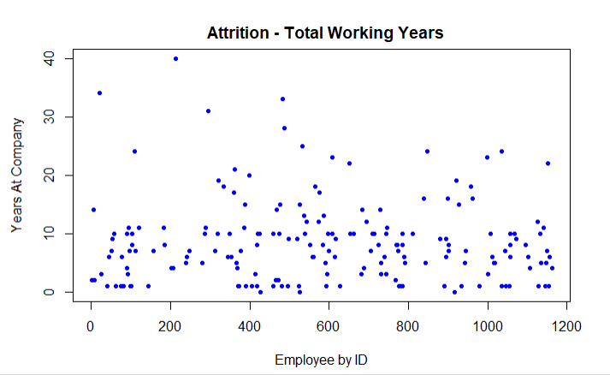
DDSAnalytics Attrition Trends

Slide 5
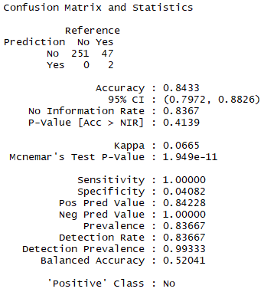
DDSAnalytics Expected Attrition
Built a Prediction Model with 84% Accuracy to Predict Attrition
Validated prediction results against CDF’s actual data
Out of the 300 employee records used in the experiment, the model predicted 253 attrition cases accurately, hence the 84% accuracy.

Slide 6

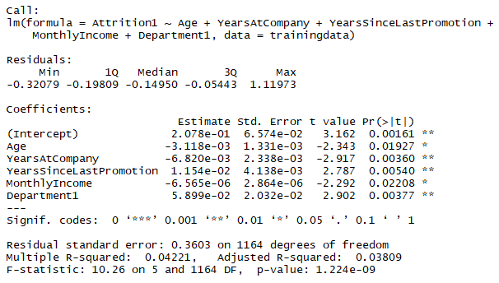
DDSAnalytics Attrition Top Factors
Three (3) Top Factors Contributing to CDF’s Attrition
Years since last promotion
Income
Years with the company

Slide 7
Thank you!
DDS Analytics

Slide 8
Appendix

Slide 9
DDSAnalytics Outline
Executive Summary
Data description
Encoding of response variable since the response variable is a categorical variable
Analytical Approach
Trends
Modeling selection
Fitting the model
Prediction

